Slide 1


Let there be…
Zero Point Energy Pvt ltd
Redefining energy conservation modes

Slide 2
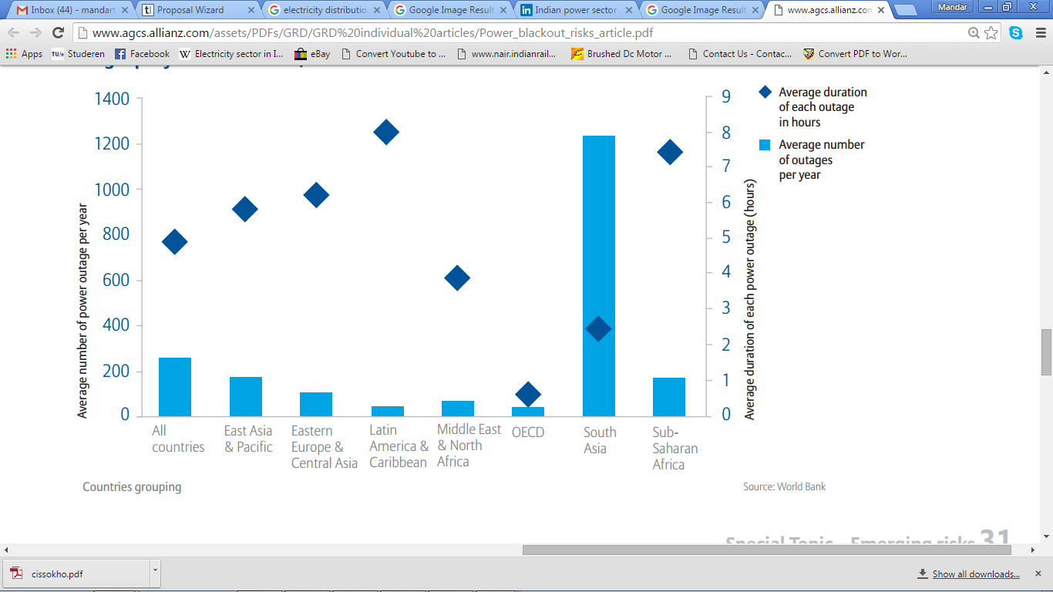
Global power outages
Indian sub continent

Slide 3
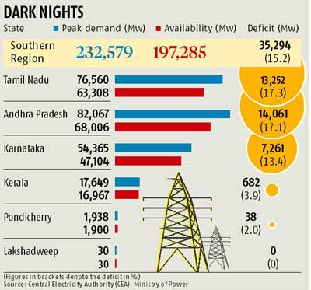
Demand- supply gap

Slide 4
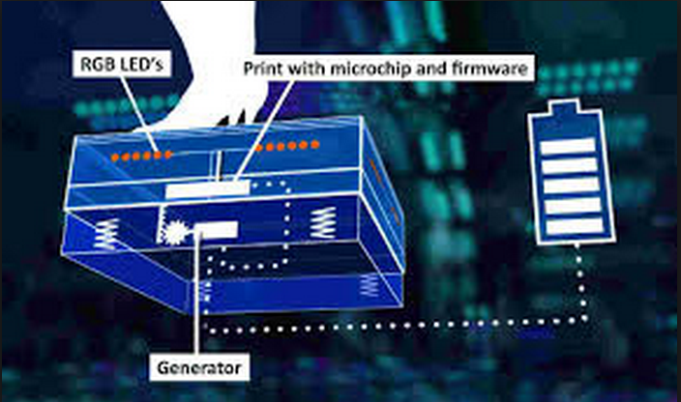
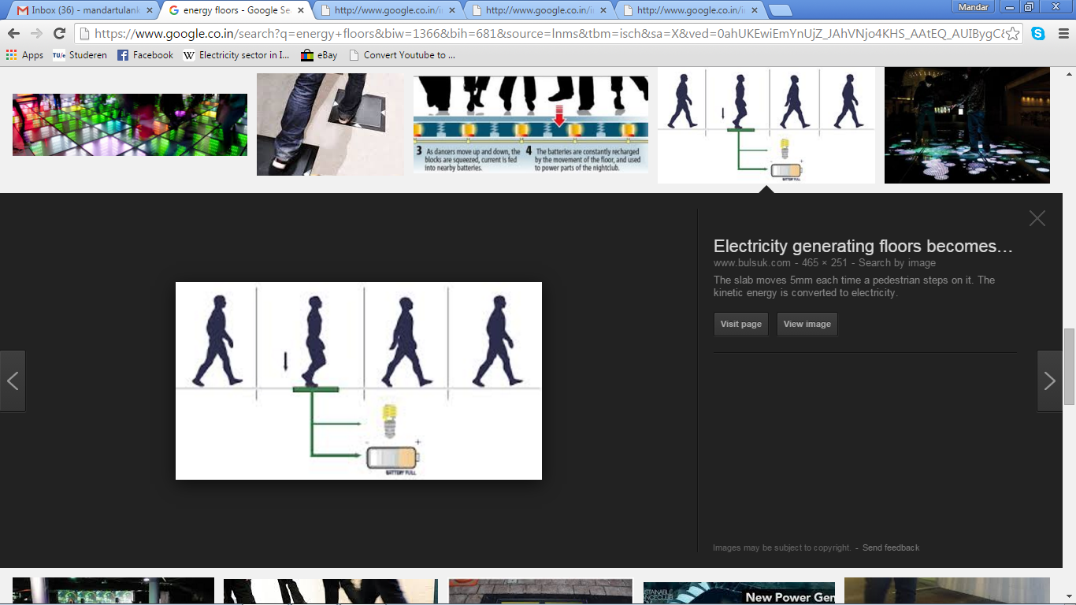
Working principle

Slide 5
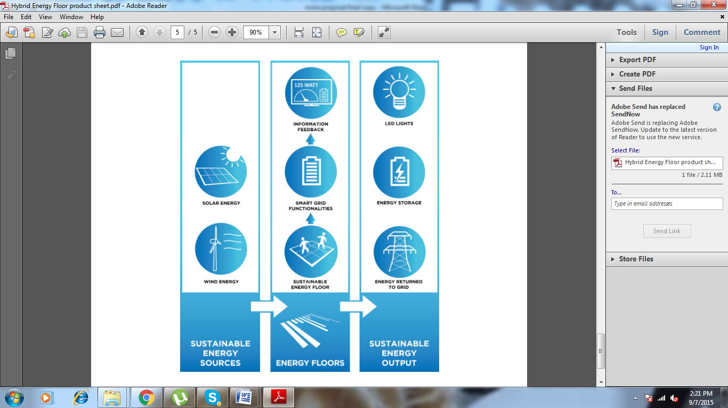
Flow chart

Slide 6
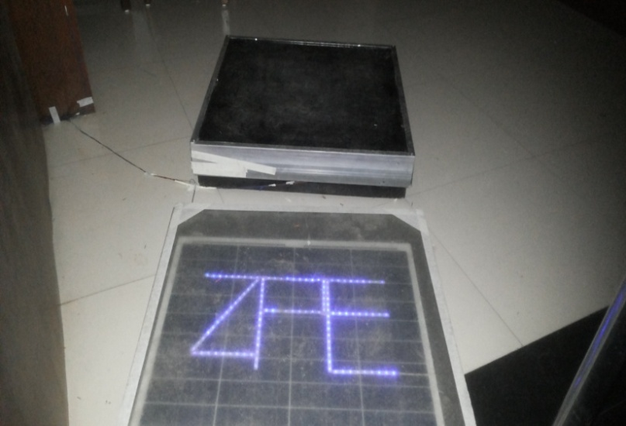
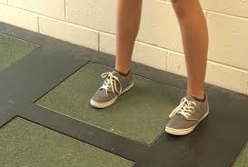
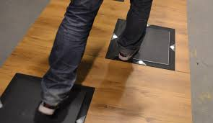
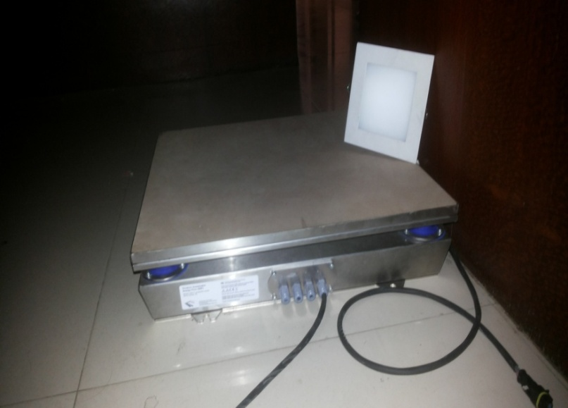
Actual Images

Slide 7
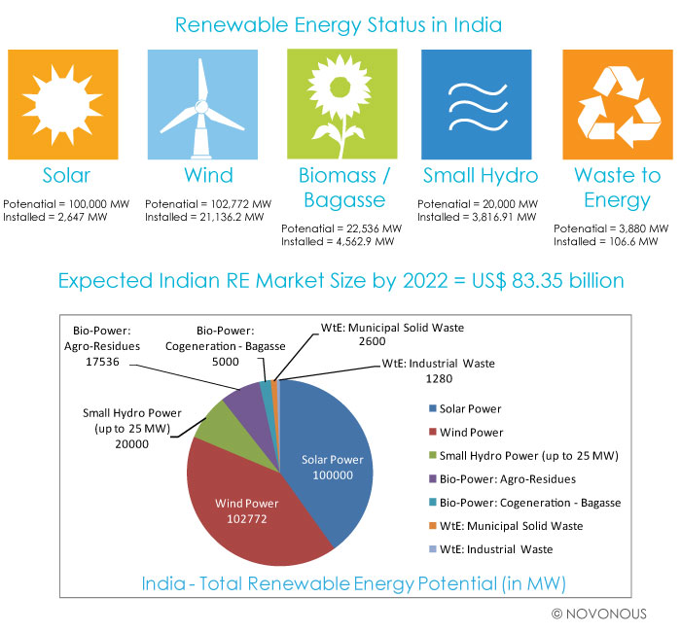
Renewable energy status in India

Slide 8
Expected RE market size by 2022
=
US $ 83.35 billion

Slide 9
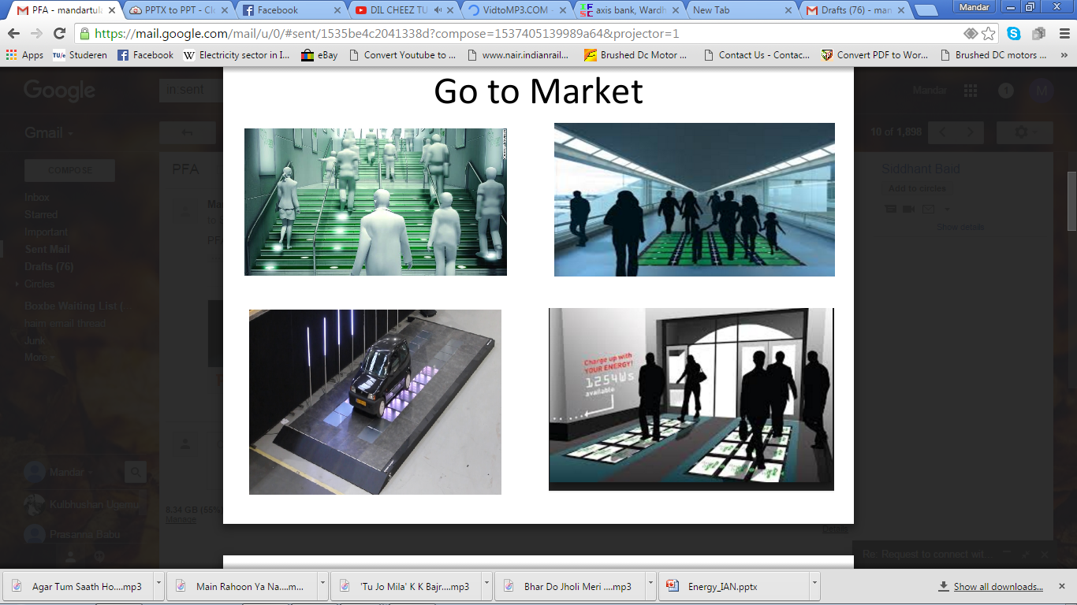
Go to market
Stair cases
Sky walks
Roads
Entry /Exit Gates

Slide 10
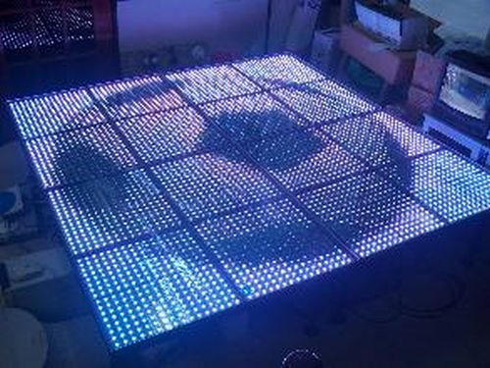
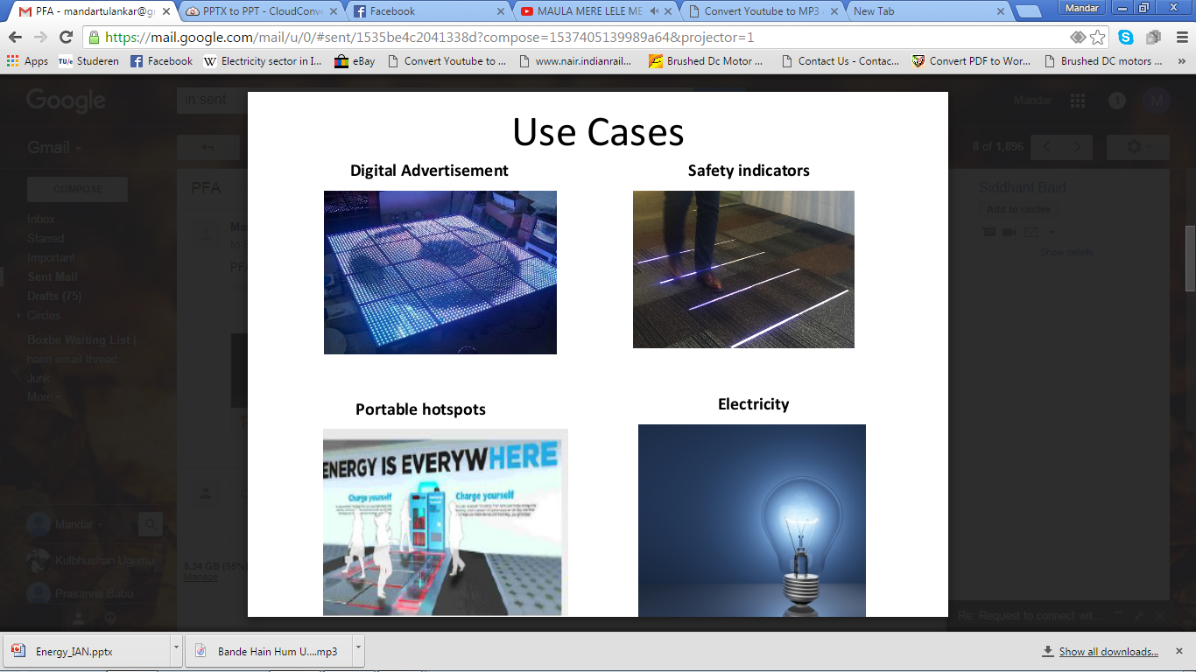
Use cases
Digital advertising
Portable charging stations
Safety Indicators
Electricity

Slide 11
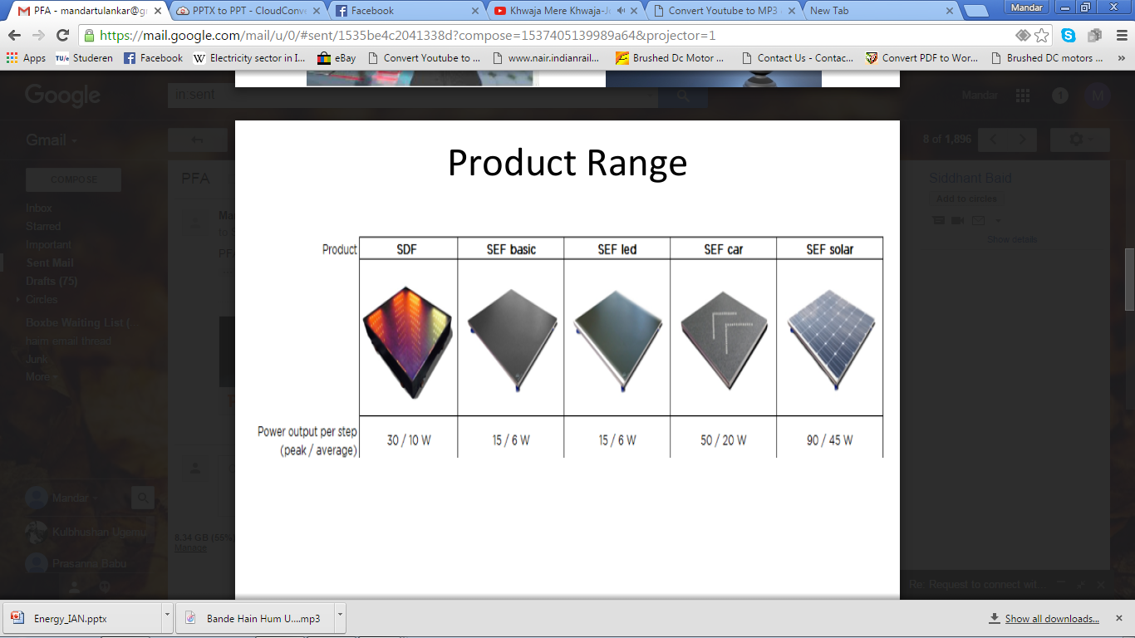
Product Range

Slide 12
Electricity output with 50 tiles
Name of square | Capacity of tile | Proposed no of tiles | Pedestrians per hour | electricity generated = tiles*pedestrian per hour | Kilo watt hour
Variety square | SEF SOLAR 50 watt | 50 | 2638 | 1,31,900 watt hour | 131.9 KWH
Jhansi rani | SEF SOLAR 50 watt | 50 | 2186 | 1,09,308 watt hour | 109.308 KWH
Cotton market | SEF SOLAR 50 watt | 50 | 249 | 12,498 watt hour | 12.498 KWH

Slide 13
Product Information.
Dimensions and weight
Width: 750mm I Depth: 750mm I Height: 115mm I Weight: 15-45 KG
Power specifications
Average power: 7W @ 24VDC during step I Peak power: 90W @ 24VDC
Force limitations
Maximum input force: 5kN I Maximum force: 200kg per module
Certifications and standard compliance
IEC-standard 60529 (water- and dust): IP67 I Other relevant standards: CE, RoHS, WEEE

Slide 14
Way forward
3 months
Pilot done I Customer engagements a) Private b) Public
6 month
1 private customer freezed (100 tiles min )
12 months
3 Permanent installations done (100 tiles min )
2nd year
6 permanent installations done (100 tiles min) I 1st international client freezed
3rd year
3 international clients freezed 20 installations (50 tiles min)

Slide 15
3 year Financial projection
 | Year 0 | Year 1 | Year 2
Revenue ( Figures in lakh )
Unit selling price | 1.5 | 1.3 | 1.1
No of tiles | 300 | 600 | 1000
Total selling price | 450 | 780 | 1100
Expenditure
Production cost (per tile) | 1 | 0.9 | 0.8
Total cost Mentioned no tiles | 300 (300 tiles) | 540 (600 tiles) | 800 (1000 tiles)
Marketing expenditure | 60 | 60 | 80
Logistics (indicative figures) | 12 | 20 | 30
Installation (indicative figures) | 50 | 50 | 70

Slide 16
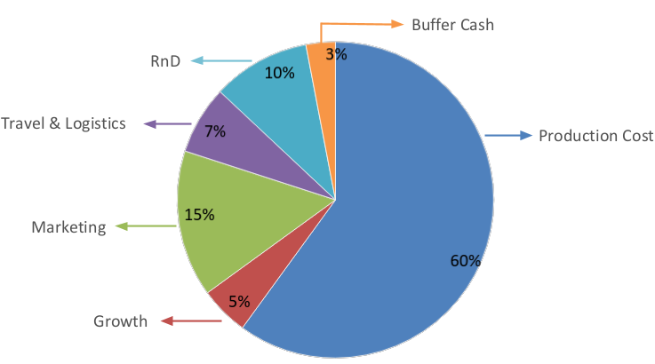
Cash Flow

Slide 17
Team
Name | Designation | Expertise
Parth Majumdar | Director | Business experience of 2 decades
Mandar Tulankar | Director | Research experience of more than half decade
Mahantesh Kamat | Tech lead | Product development experience of 4 years
Praveen Kumar | Designer | design experience of 4 years
Ninad Bhalerao | CA | financial consultant experience of more than half decade
Rami Alfasos | International out reach for UK | business experience of 4 years
Paola Schultz | International out reach for Switzerland | business experience of more than a decade

Slide 18
Advisory Board
Name | organization
Abhijeet Mahurkar | SSK Infotech - India
Willi schroll | Strategic labs - Germany
Kaustubh Dhargalkar | Welignkar Institute of technology - India
Shashikant Choudhary | Nagpur Angels
Yashveer Singh | Oxford University
Raj Bhat | Ourea capital
Dr Radha Krishnan | M.I.T India
Dr Kapil Chandrayan | Research scholar (President Vidharbha development cell )

Slide 19
Thank you

